Slide 2
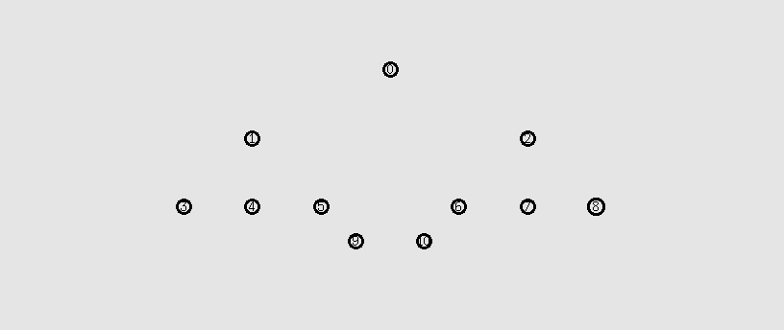

Slide 3
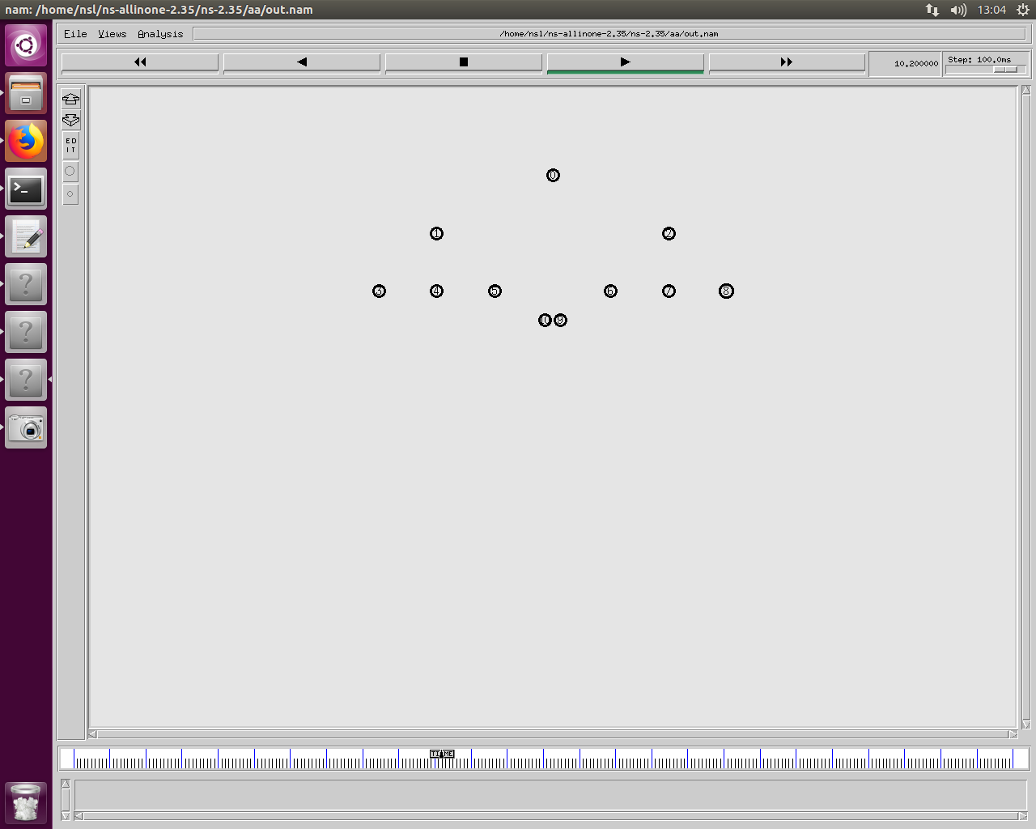
70.71

Slide 4
History 1
Threshold | Packets in network | Destination 9 Loss | Destination 10 Loss
0 | 258 | 217 | 217
0.1 | 258 | 217 | 217
0.2 | 258 | 217 | 217
0.3 | 258 | 205 | 205
0.4 | 258 | 204 | 204
0.5 | 258 | 192 | 192
0.6 | 258 | 191 | 191
0.7 | 258 | 190 | 190
Packets in network 258 – Constant
Best case Threshold 0.5 192 loss

Slide 5
History 2-10
Threshold | Packets in network | Destination 9 Loss | Destination 10 Loss
0 | 258 | 219 | 219
0.1 | 258 | 219 | 219
0.2 | 258 | 219 | 219
0.3 | 258 | 204 | 204
0.4 | 258 | 204 | 204
0.5 | 258 | 189 | 189
0.6 | 258 | 192 | 192
0.7 | 258 | 189 | 189
Packets in network 258 – Constant
Best case Threshold 0.5 189 loss

Slide 6
Closer Nodes
Threshold | Packets in network | Destination 9 Loss | Destination 100 Loss
0 | 14634 | 0 | 0
0.1 | 14733 | 0 | 0
0.2 | 14351 | 0 | 1
0.3 | 14936 | 0 | 0
0.4 | 14791 | 0 | 0
0.5 | 14845 | 0 | 0
0.6 | 14674 | 0 | 0
0.7 | 14674 | 0 | 0
55.9

Slide 7
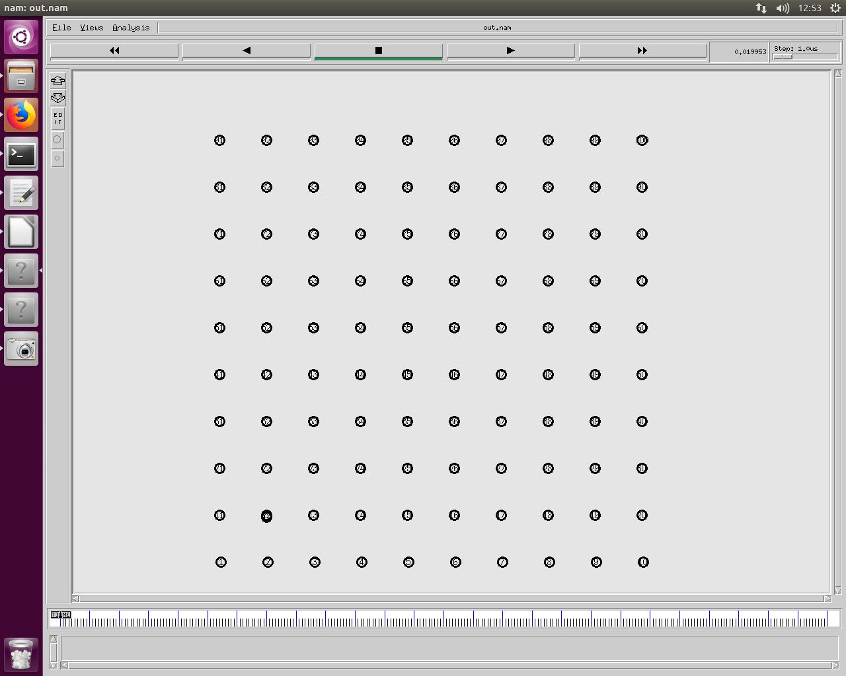

Slide 8
History 1
Threshold | Packets in network | Destination 66 Loss | Destination 100 Loss
0 | 119006 | 12 | 16
0.1 | 119006 | 12 | 16
0.2 | 138036 | 0 | 4
0.3 | 150487 | 0 | 0
0.4 | 150637 | 0 | 0
0.5 | 150708 | 1 | 1
0.6 | 151707 | 0 | 0
0.7 | 151707 | 0 | 0
Packets in the network 119006
Threshold 0-0.1 loss 12 and 66

Slide 9
History 9
Threshold | Packets in network | Destination 66 Loss | Destination 100 Loss
0 | 119006 | 12 | 16
0.1 | 119006 | 12 | 16
0.2 | 137713 | 0 | 4
0.3 | 150105 | 0 | 0
0.4 | 150339 | 0 | 1
0.5 | 150708 | 1 | 1
0.6 | 151707 | 0 | 0
0.7 | 151707 | 0 | 0
Packets in the network 119006
Threshold 0-0.1 12 and 66 loss

Slide 10
History 10
Threshold | Packets in network | Destination 66 Loss | Destination 100 Loss
0 | 119006 | 12 | 16
0.1 | 80302 | 2 | 0
0.2 | 55736 | 0 | 4
0.3 | 38518 | 0 | 113
0.4 | 2181329855 | 0 | 29
0.5 | 2181329855 | 0 | 29
0.6 | 2181329855 | 0 | 29
0.7 | 2181329855 | 0 | 29
Packets in the network 55736
Threshold 0.2 loss 0 and 4

Slide 11
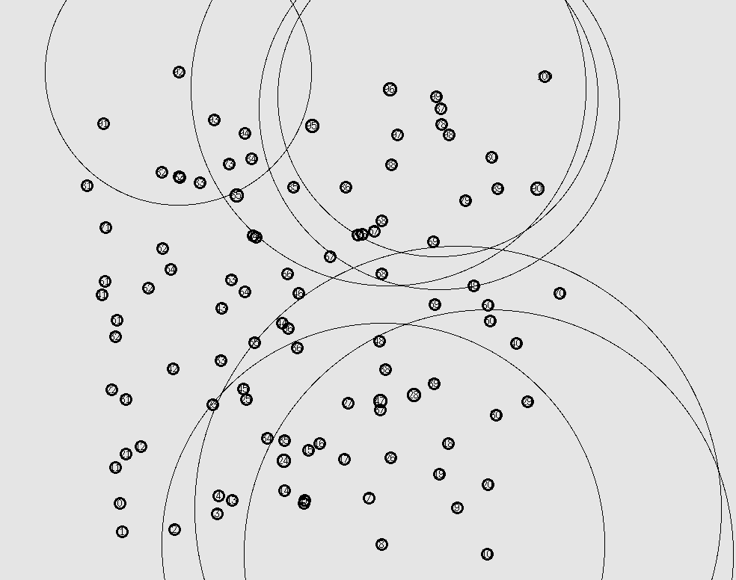

Slide 12
History 1
Threshold | Packets in network | Destination 66 Loss | Destination 100 Loss
0 |  | 0 | 0
0.1 |  | 0 | 0
0.2 | 83210 | 237 | 242
0.3 |  | 0 | 0
0.4 |  | 0 | 0
0.5 | 17187 | 233 | 240
0.6 | 120575 | 0 | 51
0.7 |  | 0 | 0

Slide 13
History 1
Threshold | Packets in network | Destination 66 Loss | Destination 10 Loss
0 |  | 0 | 0
0.1 | 2846 | 247 | 249
0.2 | 52331 | 0 | 239
0.3 |  | 0 | 0
0.4 | 129074 | 1 | 178
0.5 | 85222 | 11 | 239
0.6 | 127626 | 0 | 21
0.7 | 114604 | 27 | 113

Slide 14
Threshold | Packets in network | Destination 66 Loss | Destination 100 Loss
0 |  | 0 | 0
0.1 |  | 0 | 0
0.2 | 83210 | 237 | 242
0.3 |  | 0 | 0
0.4 |  | 0 | 0
0.5 | 17187 | 233 | 240
0.6 | 120575 | 0 | 51
0.7 |  | 0 | 0
Threshold | Packets in network | Destination 66 Loss | Destination 100 Loss
0 |  | 0 | 0
0.1 | 2846 | 247 | 249
0.2 | 52331 | 0 | 239
0.3 |  | 0 | 0
0.4 | 129074 | 1 | 178
0.5 | 85222 | 11 | 239
0.6 | 127626 | 0 | 21
0.7 | 114604 | 27 | 113

Slide 15
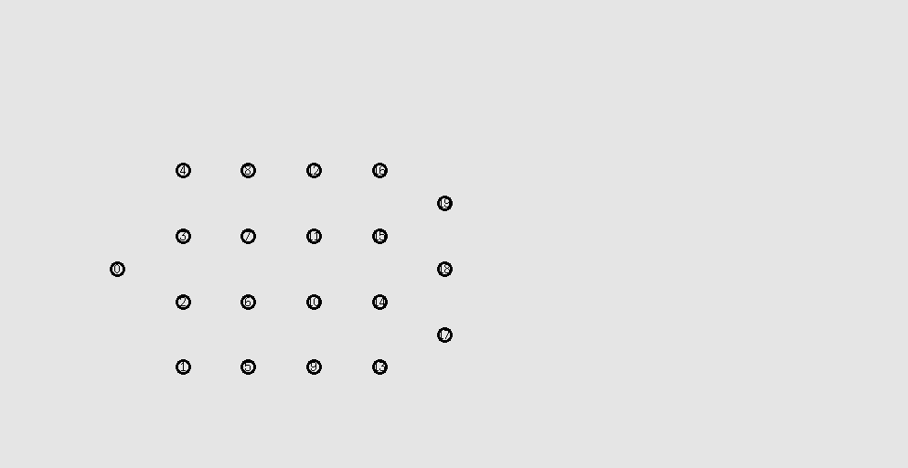
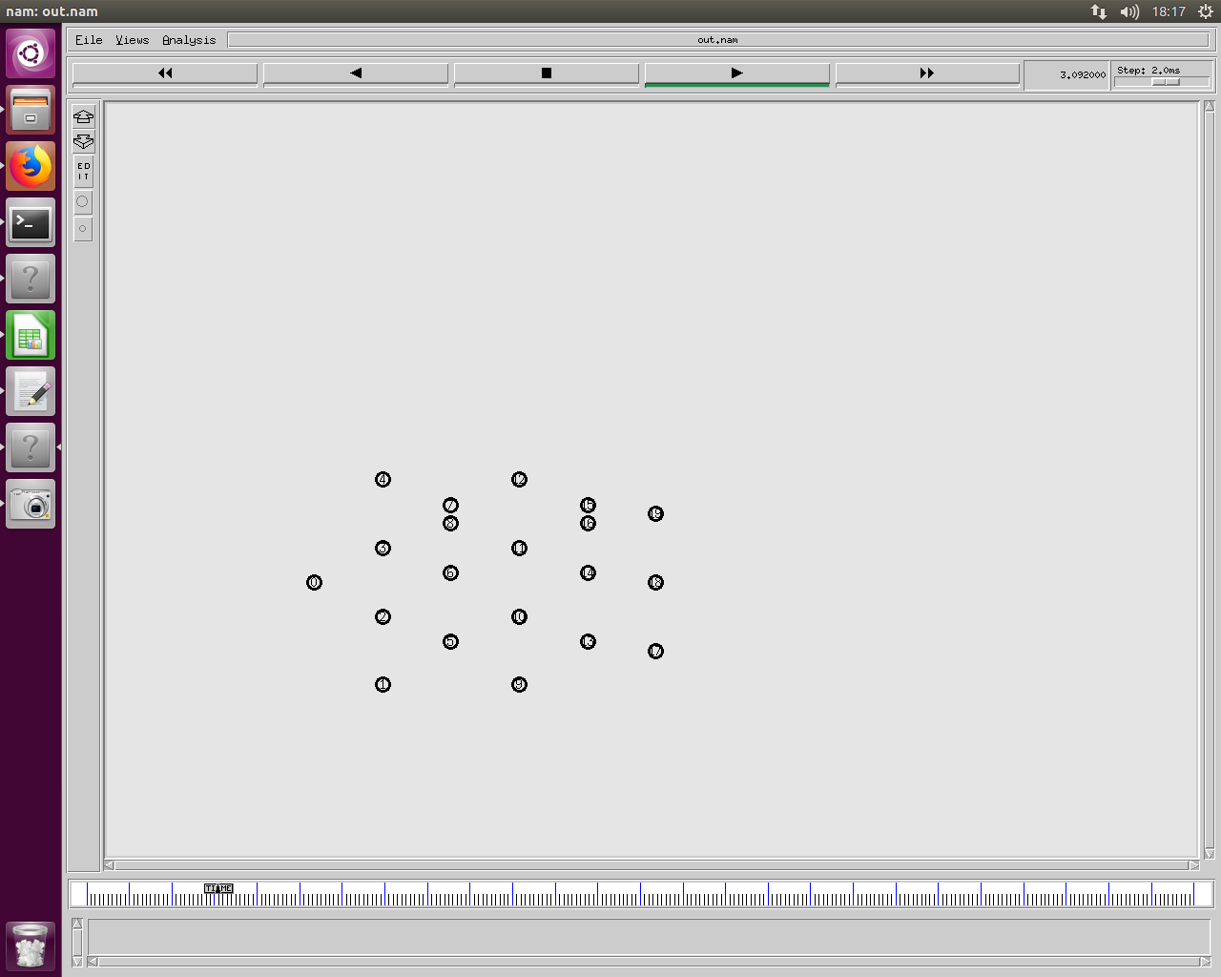

Slide 16
History 1-10
Threshold | Packets in network | Destination 17 Loss | Destination 18 Loss | Destination 19 Loss
0 | 13863 | 40 | 75 | 62
0.1 | 13863 | 40 | 75 | 62
0.2 | 11974 | 68 | 90 | 88
0.3 | 21573 | 14 | 14 | 14
0.4 | 22844 | 7 | 7 | 7
0.5 | 23001 | 6 | 6 | 6
0.6 | 23002 | 7 | 7 | 7
0.7 | 22743 | 11 | 11 | 11
Packets 11974
Threshold 0.2 loss 68 90 88

